Slide 1
Exits
Determine the remoteness of exits
Calculate the capacity of exits

Slide 2
Historic Fire
Katie Jane Memorial Home

Slide 3
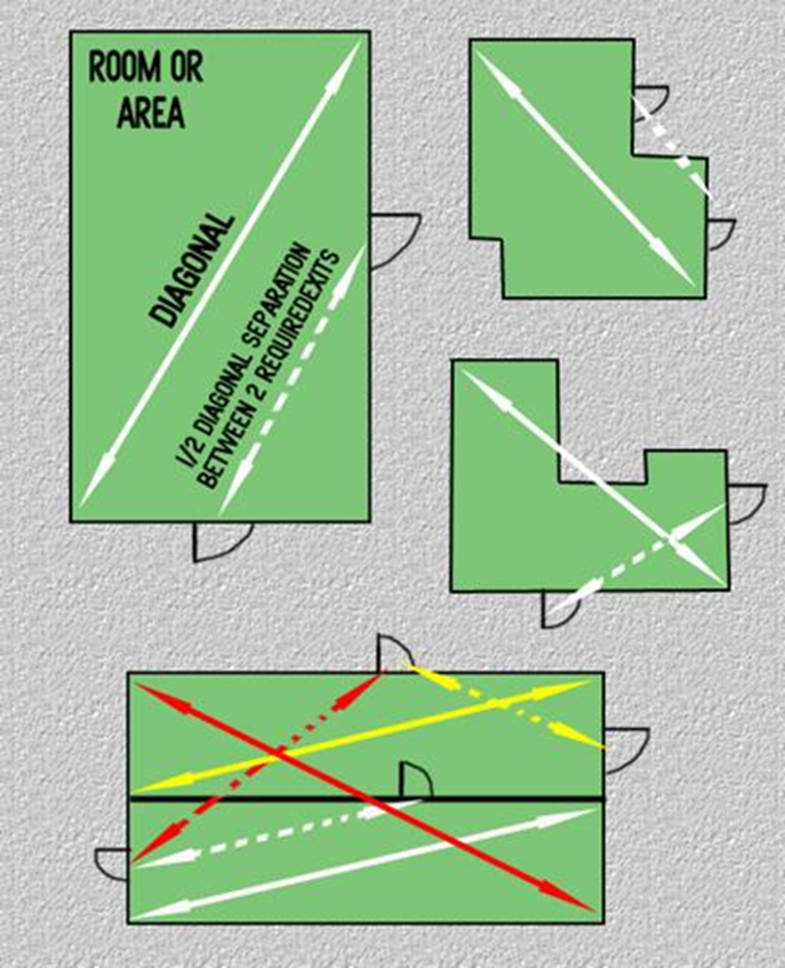
Remote
Rules for two exits
  Additional exits as far apart as is practical
Sprinkler trade-off
No familiarity requirements

Slide 4
Requirements
Openings from normally occupied spaces
Rating depends on building height
  1 hr for 3 stories or less
  2 hr for 4 stories or more

Slide 5
Discharge
Remote
All outside
  50 % in some instances
Barrier

Slide 6
Capacity
Typically for existing buildings
  Change of use
  Reconstruction on floor
Look for limiting component
  More to consider than just the first component
Rounding

